Slide 1



Titlu lucrare
Conducător(i) Științific(i):
Prof./Conf./Ș.l./As. dr.ing. Prenume NUME
Student(ți):
Prenume NUME
Sesiunea de Comunicări Științifice Studențești – SCSS 2024, 10-11 mai 2024

Slide 2
Titlu capitol
Text Text Text Text Text Text Text Text Text Text Text Text Text Text Text Text Text Text Text Text
Text Text Text Text Text Text Text Text Text Text Text Text Text Text Text Text Text Text Text Text
Text Text Text Text Text Text Text Text Text Text Text Text Text Text Text Text Text Text Text Text
Text Text Text Text Text Text Text Text Text Text Text Text Text Text Text Text Text Text Text Text
Fig. 1. Dezvoltarea super-rețelei europene

Slide 3
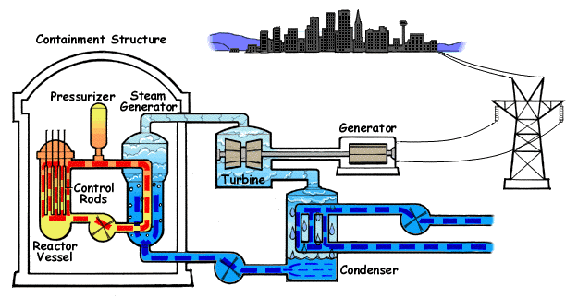
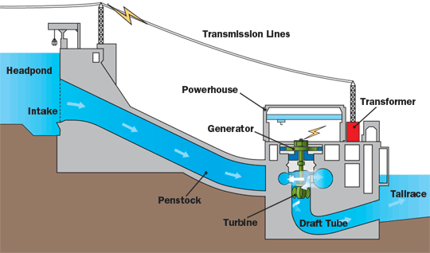


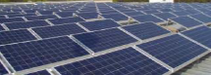
Titlu capitol
Text Text Text Text Text Text Text Text Text Text Text Text Text Text Text Text Text Text Text Text Text Text Text Text
Text Text Text Text Text Text Text Text Text Text Text Text Text Text Text Text Text Text Text Text Text Text Text Text
Text Text Text Text Text Text Text Text Text Text Text Text Text Text Text Text Text Text Text Text Text Text Text Text

Slide 4
Titlu capitol
Text Text Text Text Text Text Text Text Text Text Text Text Text Text Text Text Text Text Text Text Text Text Text Text Text Text Text Text Text Text Text Text Text Text Text Text Text Text Text Text
Text Text Text Text Text Text Text Text Text Text Text Text Text Text Text Text Text Text Text Text Text Text Text Text Text Text Text Text Text Text Text Text Text Text Text Text Text Text Text Text

Slide 5
Titlu capitol
Hypotheses: Inertia constant H = 6.5 s; only hydroelectric units are considered for frequency control.
a) Frequency variation
b) Power contribution
Hypotheses: Inertia constant H = 3 s; only hydroelectric units are considered for frequency control.

Slide 6
Concluzii
Text Text Text Text Text Text Text Text Text Text Text Text Text Text Text Text Text Text Text Text Text Text Text Text Text Text Text Text Text Text Text Text Text Text Text Text Text Text Text Text
Text Text Text Text Text Text Text Text Text Text Text Text Text Text Text Text Text Text Text Text Text Text Text Text Text Text Text Text Text Text Text Text Text Text Text Text Text Text Text Text
Text Text Text Text Text Text Text Text Text Text Text Text Text Text Text Text Text Text Text Text Text Text Text Text Text Text Text Text Text Text Text Text Text Text Text Text Text Text Text Text
Text Text Text Text Text Text Text Text Text Text Text Text Text Text Text Text Text Text Text Text Text Text Text Text Text Text Text Text Text Text Text Text Text Text Text Text Text Text Text Text

Slide 8
